Slide 1
Sistem Berdasar Mikroprosesor
Project Akhir
Juz’an Nafi Haifa (45830)

Slide 2
Topic
Membuat simulasi perempatan/persimpangan jalan lampu merah (bangjo) atau perlintasan kereta api.
Lampu: LED (merah, kuning, hijau)
Countdown: 7-segment → OLED I2C
Sensor:
Ultrasonic: deteksi kendaraan lewat
Aktuator:
Servo → penutup palang, atau
Buzzer → alert pelanggaran
Input lain: 4x4 keypad, push button
Jalur Komunikasi: I2C > SPI > UART

Slide 3
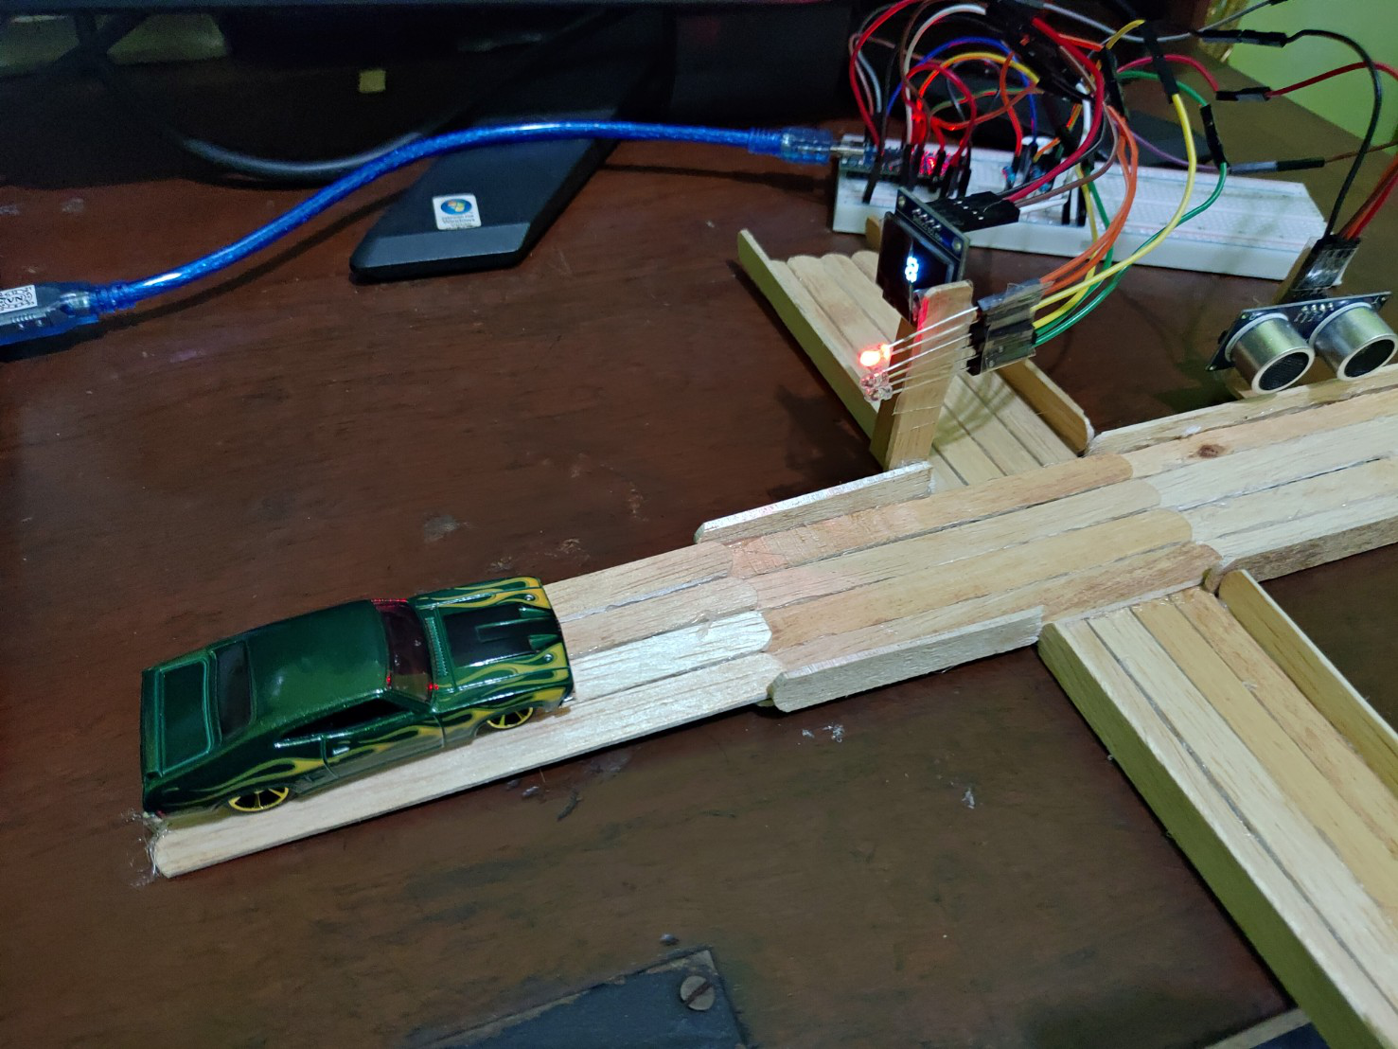
System Overview simulasi perempatan lampu merah
Sensor Ultrasonik
Sumber alert
Lampu Lalu Lintas
28
Kendaraan
Countdown

Slide 4


System Overview

Slide 5

System Overview

Slide 6
Constraints
Sistem hanya menunjukkan satu arah sudut pandang saja.
Durasi countdown dibuat lebih cepat daripada aslinya.
Decrement countdown tidak persis 1 detik, tetapi mendekati 1 detik.

Slide 7
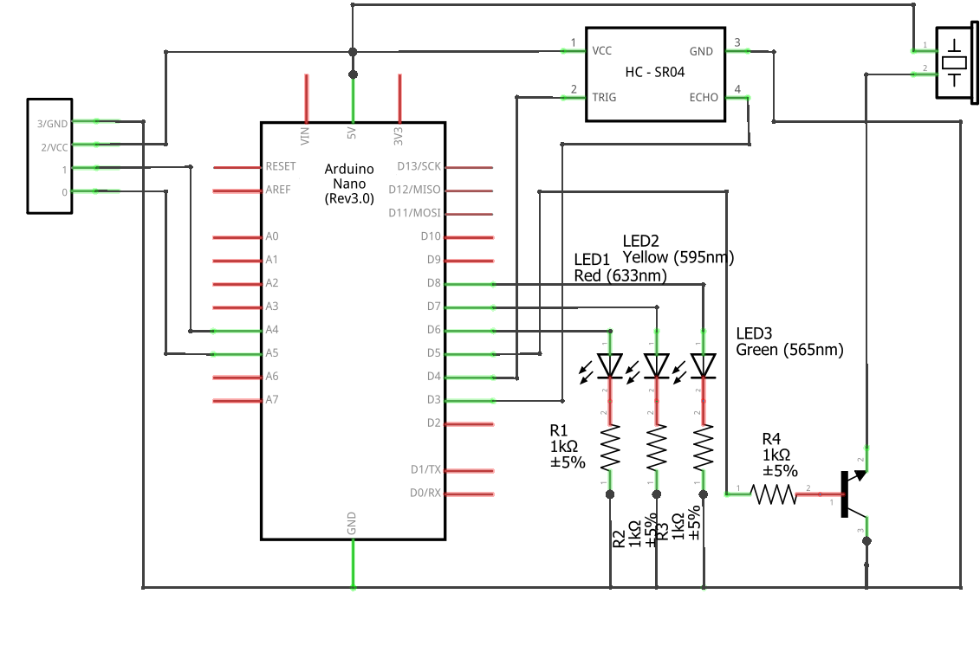
Schematic Diagram
Sensor Ultrasonik
Piezo Buzzer
OLED
1/SDA
0/SLC
PD8/
PD7/
/PC4/SDA
PD6/
/PC5/SLC
T1/PD5/
T0/PD4/
INT1/PD3/
Transistor
NPN BC337

Slide 8
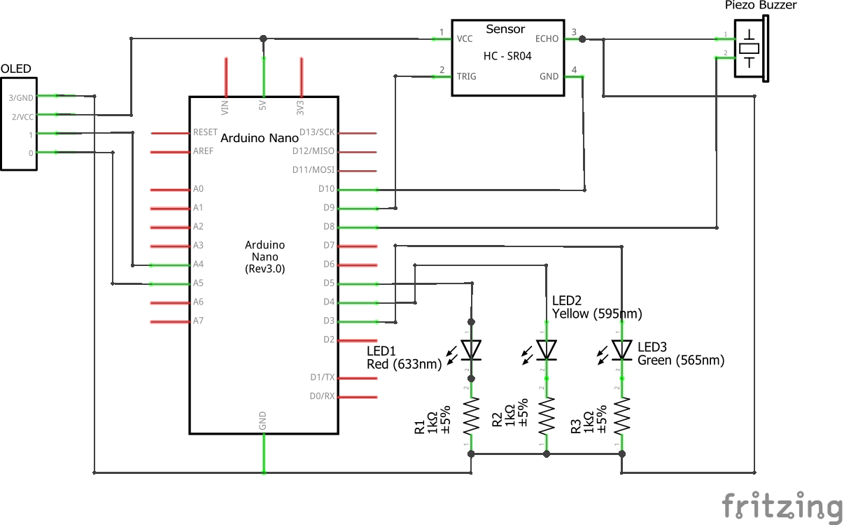
Schematic Diagram (rev)
GND
ECHO
1/SDA
0/SLC
PB2/
PB1/
PB0/
/PC4/SDA
/PC5/SLC
T1/PD5/
T0/PD4/
INT1/PD3/

Slide 9
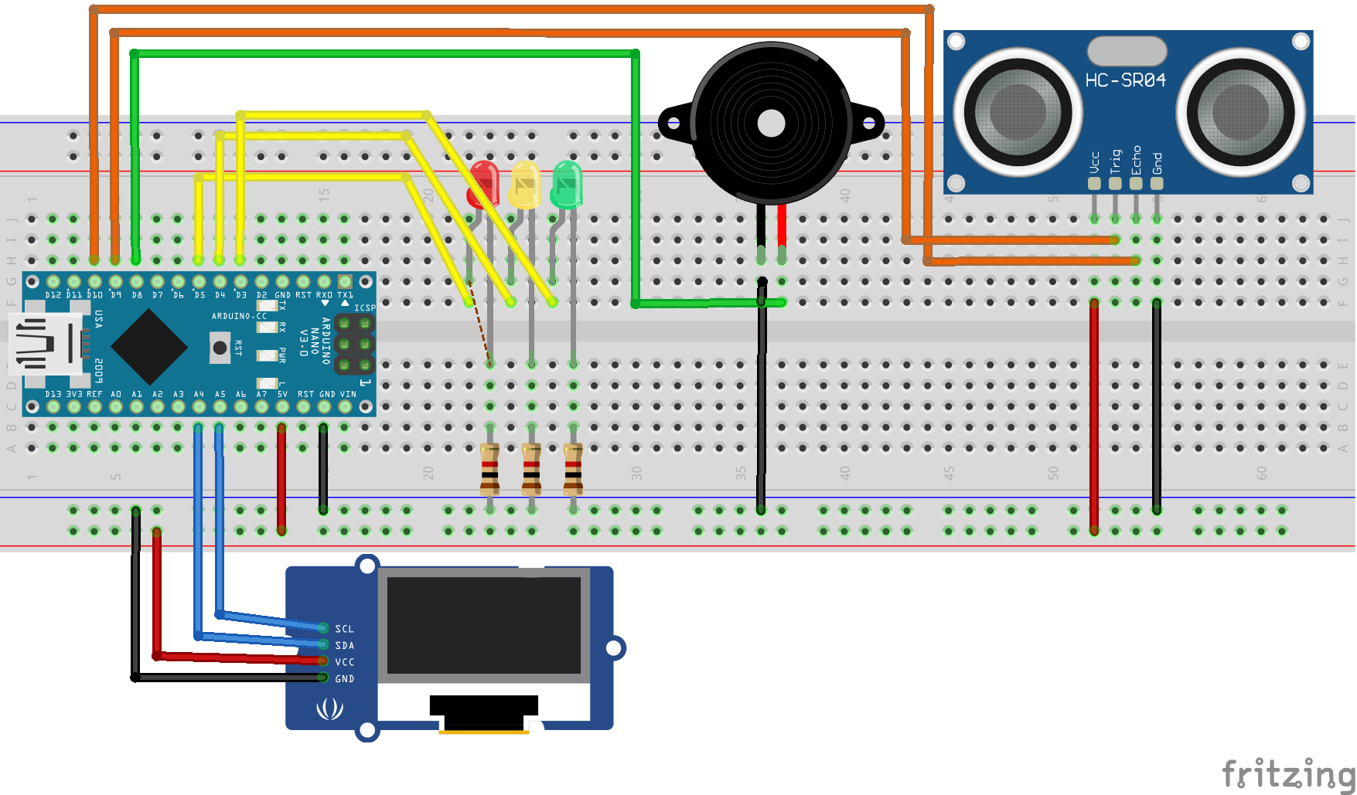
Fritzing Diagram

Slide 10
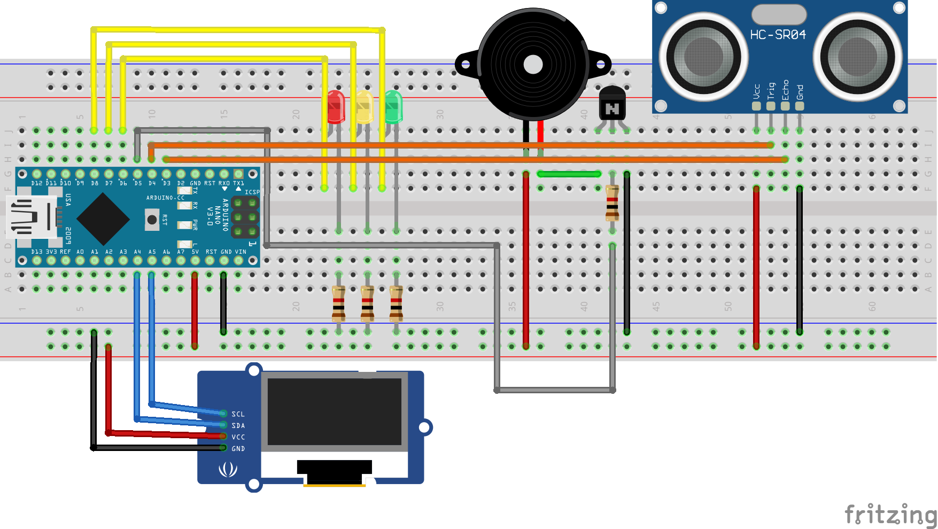
Piezo Buzzer
Sensor Ultrasonik
LEDs
Transistor
Arduino Nano
OLED I2C

Slide 11
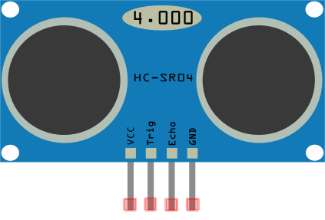
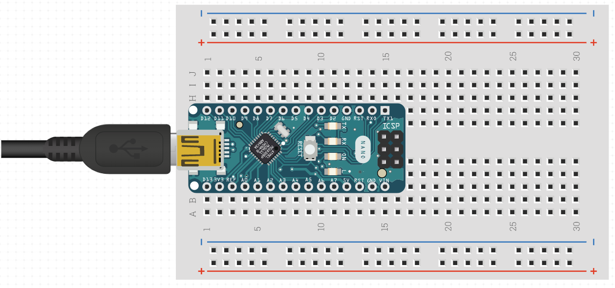




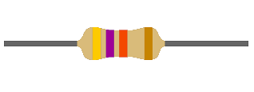
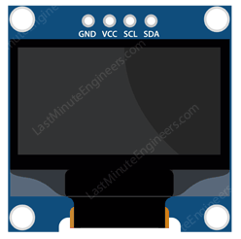
Schematic Diagram

Slide 12
Bill of Materials
Materials | Price (IDR) | Amount | Total Price (IDR)
Arduino Nano | 39,900 | 1 | 39,900
USB Mini-B Cable | 10,000 | 1 | 10,000
Breadboard 400 pins | 14,400 | 1 | 14,400
LEDs | 300 | 3 | 900
OLED I2C 128x64 display | 39,000 | 1 | 39,000
Ultrasonic sensor | 12,000 | 1 | 12,000
Piezo Buzzer | 2,000 | 1 | 2,000
Jumpers | 350 | 36 | 12.600
Resistors | 100 | 3 | 300
Total Bills:
IDR 131,100

Slide 13
Program Workflow
Ada 2 proses dalam satu sistem:
Lampu lalin (countdown)
Deteksi kendaraan (sensor)
void loop(){
countdown--;
⋮
// sensor: distance acquisition
}
approx.
1 second

Slide 14
Program Workflow
0
countdown := 10
countdown := 5
1
2
if (countdown == -1){
// state change
// generate new countdown
}
countdown := 2
Countdown
state control
State
state | Red | Yellow | Green
0 | HIGH | LOW | LOW
1 | LOW | HIGH | LOW
2 | LOW | LOW | HIGH
LED control
OLED control
→ Display countdown

Slide 15
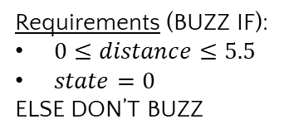
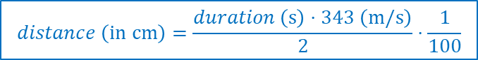

Program Workflow
Sensor
(ultrasonic)
$$distance \left(in cm\right)=\frac{duration \left(s\right)⋅343 \left(m/s\right)}{2}⋅\frac{1}{100}$$
Duration
Distance
State
Piezo Buzzer control
Requirements (BUZZ IF):
$0≤distance≤5.5$
$state=0$
ELSE DON’T BUZZ
$$∪distance≥10$$

Slide 16
Demo
Project Akhir Sistem Berdasar Mikroprosesor

Slide 17
Project
Membuat suatu sistem(bebas) dengan Arduino 8 bit (uno/nano/promini), dengan spek, setidaknya
Display (Oled)
Terhubung ke suatu sensor (bebas)
Mengendalikan suatu aktuator (bebas)
Mempunyai input : keypad/push button/analog
Menggunakan jalur komunikasi (UART,I2C,SPI) setidaknya satu macam
Bill of Material total maximum 150.000 IDR

Slide 18
Hardware
Minimum System Arduino 8 bit:
Uno,nano,promini (1 atau 2 unit)
8 LED + Resistor
OLED module 128x64 atau 128x32
Keypad membran (4x4 atau 3x4)
Sensor (sesuai project)
Aktuator (sesuai project)
NodeMCU (kalau sampai)

